Slide 1
Online Bus Reservation PURPLE BUS

Slide 2
TEAM TYROS -
Anshul Bansal Jitin Sharma
Omkar Bhagwat Divya Marikanti

Slide 3
INTRODUCTION
Online Bus Reservation is a web application which provides a user-friendly User Interface and an easy efficient way to search, book and cancel bus tickets. This application is currently working for a single bus transport company. User have access to search buses and apply for it. User can register on website to avail privileged facilities. On booking it provides a unique ticket number through which user can track its bus details. It also allows user to cancel bus before a specific time.

Slide 4
WHY….?
In today’s world of bus transportation many private bus transportation company have traditional approach of managing work on paper which seems to be money and time consuming. Also not guaranteed that all transaction to be error free and may lead to many calculation mistakes in bill generation and costing.
Online bus reservation system is a project which provides an online portal for bus ticket reservation. This application allows customers to book bus tickets from anywhere and anytime. The customer can easily book and cancel their tickets at their comfort. The customer can view all the details of the seats, bus, and route . The customer can also view and download the details of the journey and journey timings. This will give customer an overview of the journey and will be a hassle-free task of doing bus reservation at fingertips.

Slide 5
OBJECTIVE
The objective of application is to computerize any traveling company process to manage data, so that all the transactions become faster and there should not be any error in transactions like calculation mistake, bill generation and other things. It replaces all the paperwork. It keeps records of all the bills also, given to the customers, so that customer could update his daily accounts. All most care and back-up procedures must be established to ensure 100% successful implementation of the computerized Bus reservation system

Slide 6
FEATURES
Both the Authorized and Unauthorized customers can use this system.
The customer can search the bus details by giving source , destination and date of journey.
Customer can see the already booked seats and can only book the available seats.
After payment customer see the summary of transaction and can download the ticket details.
Authorized Customer can also view their previous , current bookings and can cancel their current bookings.
Authorized Customer can use their wallet to book the tickets and if the user cancels any ticket, money will be credited to their wallet.
Admin can view the list of all the Buses and can perform Add, Edit, Delete operations.

Slide 7
SPRINT I
Sprint 1 - Admin Panel
T No | Task | Start Date | End Date | Completed
1 | Admin Sign In Form | 26/08/2022 | 26/08/2022 | YES
2 | List of Bus | 26/08/2022 | 26/08/2022 | YES
3 | Show all details of specific bus | 26/08/2022 | 26/08/2022 | YES
4 | Add Bus | 26/08/2022 | 27/08/2022 | YES
5 | Update Bus | 26/08/2022 | 27/08/2022 | YES
6 | Delete Bus | 26/08/2022 | 27/08/2022 | YES
7 | Cancel Bus | 26/08/2022 | 27/08/2022 | YES

Slide 8
SPRINT II
Sprint 2 - Customer Panel
T No | Task | Start Date | End Date | Completed
1 | Registration Form | 29/08/2022 | 29/08/2022 | YES
2 | Check Avb | 29/08/2022 | 29/08/2022 | YES
3 | Make Booking | 29/08/2022 | 29/08/2022 | YES
4 | List of prev Bookings | 29/08/2022 | 30/08/2022 | YES
5 | Cancel Booking | 29/08/2022 | 30/08/2022 | YES
6 | Modify Booking | 29/08/2022 | 30/08/2022 | YES
7 | Feedback on Booking | 29/08/2022 | 30/08/2022 | YES
8 | Unauthorized Booking | 29/08/2022 | 30/08/2022 | YES

Slide 9
SPRINT III
Sprint 3 - Additional Features
T No | Task | Start Date | End Date | Completed
1 | Wallet | 01/09/2022 | 01/09/2022 | YES
2 | Cancel and Refund | 01/09/2022 | 01/09/2022 | YES
3 | Feedback for Reservation | 01/09/2022 | 01/09/2022 | YES
4 | Print of the Ticket | 01/09/2022 | 01/09/2022 | YES
5 | Change Password | 01/09/2022 | 01/09/2022 | YES

Slide 10
Database Tables

Slide 11
API’s

Slide 12
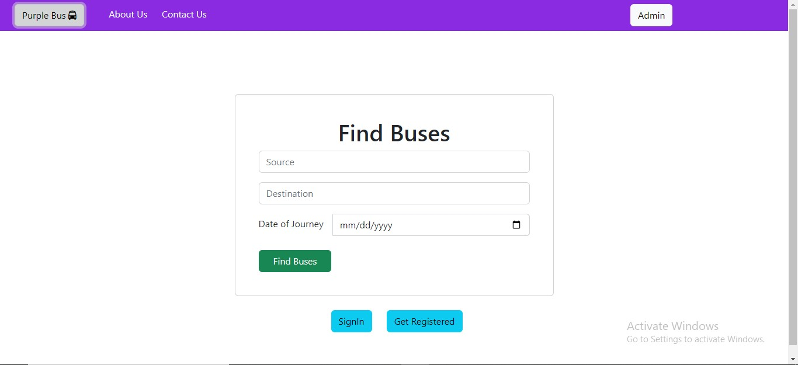
UI (HomePage)

Slide 13
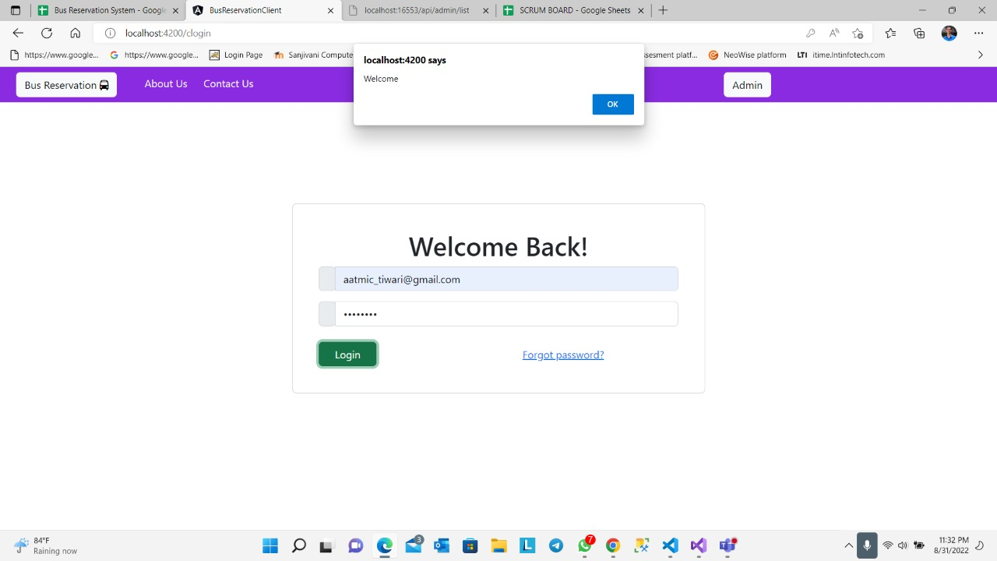
UI – Customer Login

Slide 14
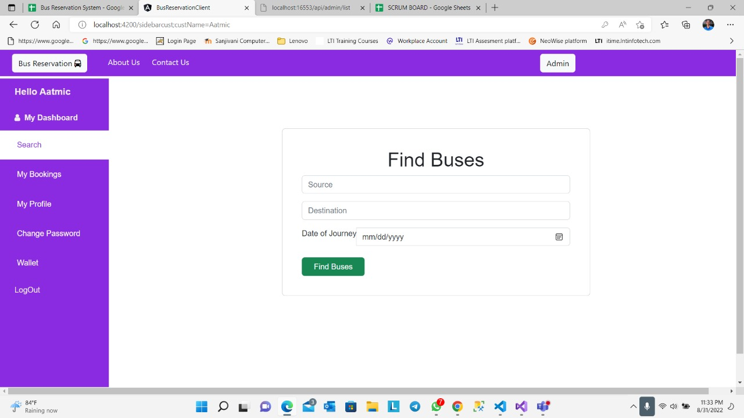
UI – Dashboard Search

Slide 15
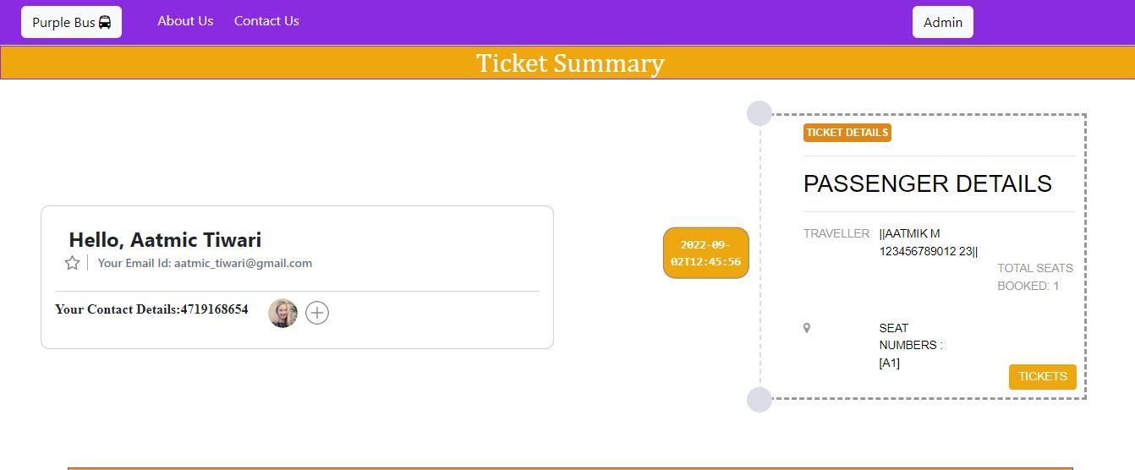
UI – Summary

Slide 16
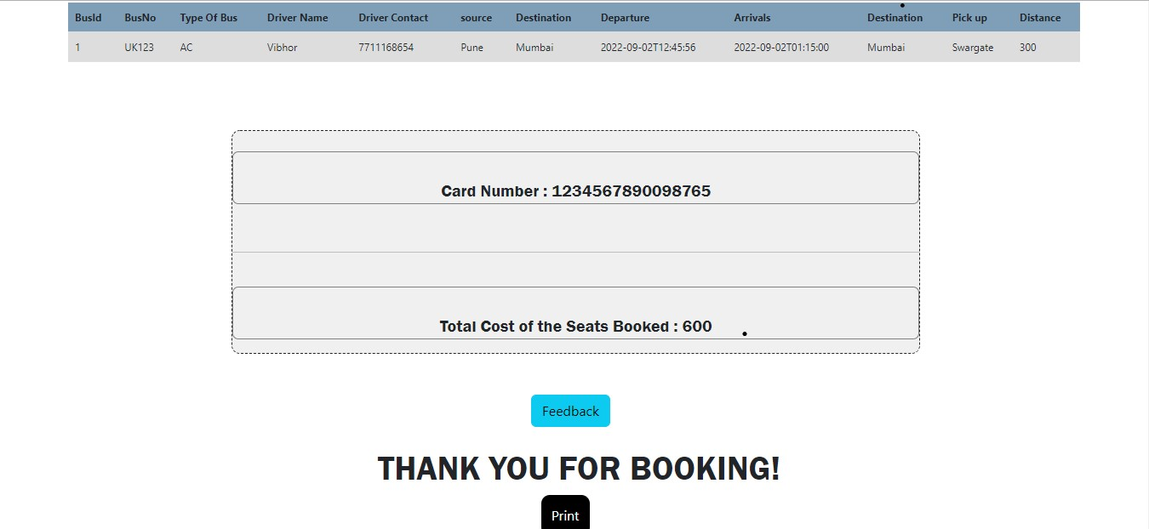
UI – Summary(Print)

Slide 17
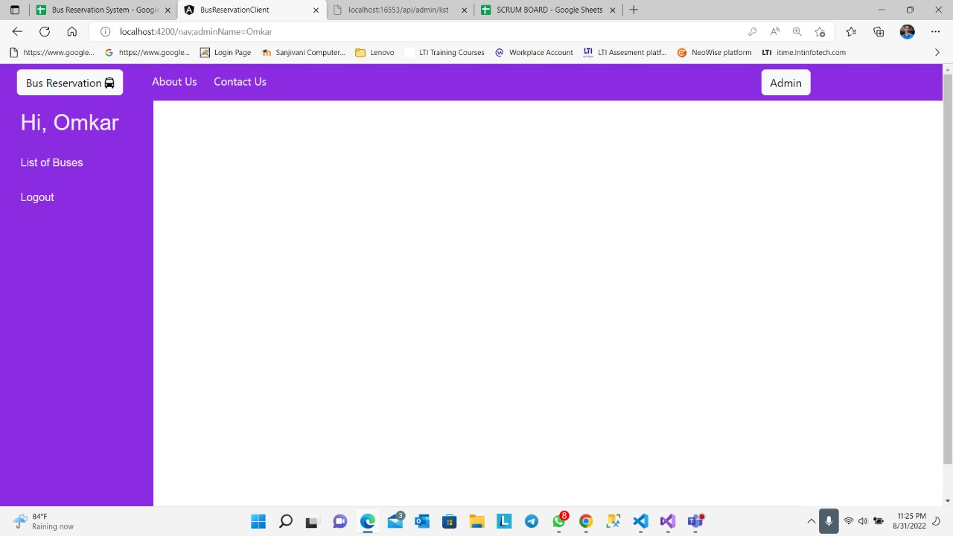
UI-Admin Dashboard

Slide 18
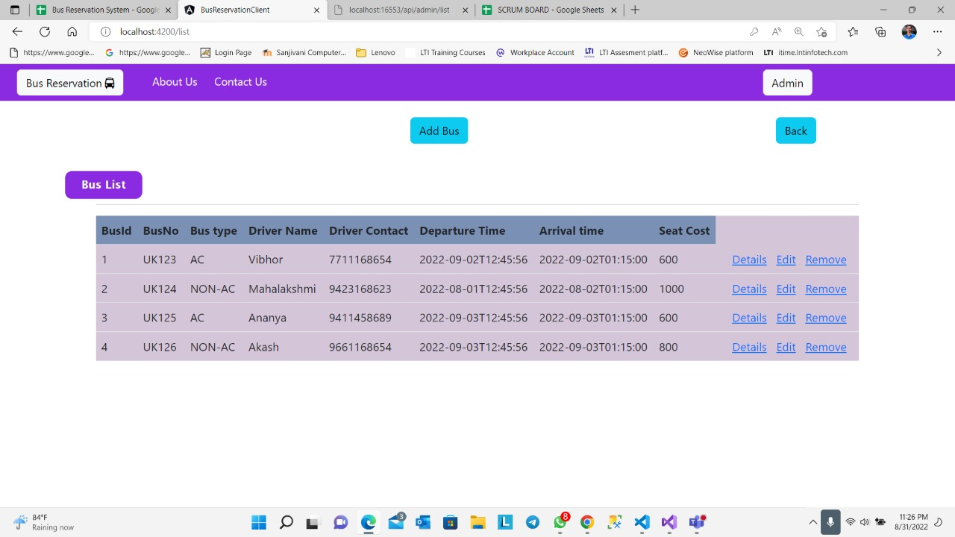
UI-Bus list

Slide 19
Challenges
I. Passing the data from one component to another component:
Problem:
We were not able to pass the data from one component to another ,we tried to resolve this using routerLink and router.navigate() but it was replicating the data across the components.
Solution:
We made central storage as class which contains public static variables. We accessed and updated those data members by importing that class inside the components.

Slide 20
Challenges
II. Seat Mapping:
Problem:
It was required to maintain the 3 states for each seat (cell in the grid) to give the functionality of showing the reserved seats, seats which are available for selection and the selected seats.
Solution:
By reframing the response from the API, we created a new array of objects and assigned 3 states to each seats, and we mapped each cell in a grid with the seat no and depending upon the status we have assigned them 3 classes (Booked, Available & Selected)

Slide 21
Challenges
III. Cyclic Error:
Problem: While working with the Create Transaction Details Api, we were getting a cyclic relationship error with the attributes used in Transaction table and other related tables.
Solution:
Changing the relations between tables, we were able to fix the problem in Bus Seat table. but again the same issue occurred. So to resolve this, first we tried changing the schema but still the same cyclic issue was presenting. Thereafter by changing the responses as Array of Arrays, we solved the error. Passenger array is used in transaction details, also the seats array is used, so by this way we resolved the error.

Slide 22
Challenges
IV. Camel Casing:
Problem:
We were facing issues while integrating the services with back-end. We were not able to fetch the data from API in the front-end.
Solution:
While Creating the Interface, Camel Casing is required at the client side. To Link up with Components the attributes should go in camel casing. This created some obstruction while displaying the data in port.

Slide 23
CONCLUSION
Working in a team gave us a wide view of implementing as well as solving problems.
Regular interaction over the process and flow
In a collaborative manner, we contributed to the whole project, while being in sync with each other.
With an agile approach used for working, we were able to find our strengths and weaknesses and worked accordingly.
Working in small iterations called sprint bridged the gaps between software development and domain of the team.
Synchronization and quick meetings gave us an ability for inter team coordination.
We used Git as our source code management tool. Its distributed nature gave all of us the freedom to experiment and develop locally and as per the functionality and readiness, publish the changes.

